Slide 1

ECE 802, Electric Motor Control Multiple Reference Frame Estimator / Regulator
P.L. Chapman and S.D. Sudhoff, “A Multiple Reference Frame Synchronous Estimator/Regulator,” IEEE Transactions on Energy Conversion, volume 15, number 2, pages 197-202, June 2000.

Slide 2
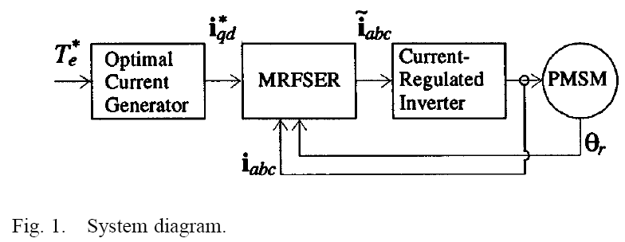
MRF Control

Slide 3
Transformations
Transformation
Inverse transformation
N - set of all harmonics considered

Slide 4
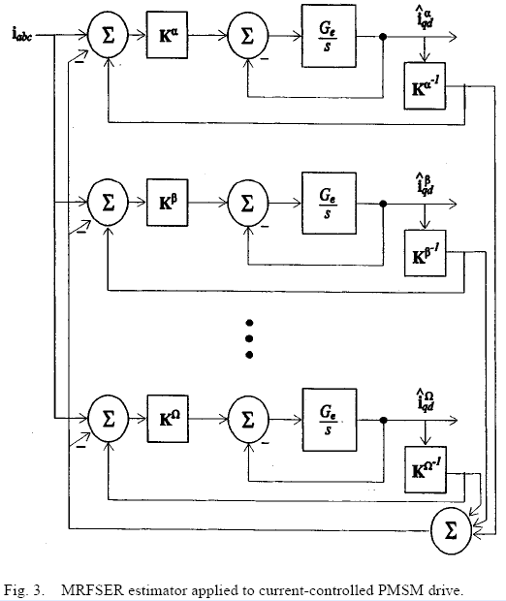
Estimator
as e_{α} → 0
e_{β} → 0
e_{Ω} → 0

Slide 5
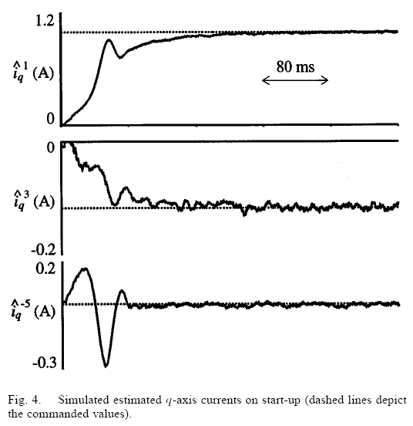
Estimator Example: N is { 1, 3, -5 }

Slide 6
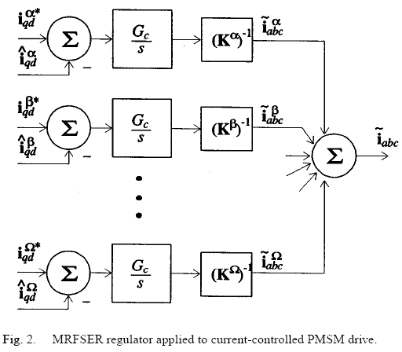
Regulator

